Slide 1
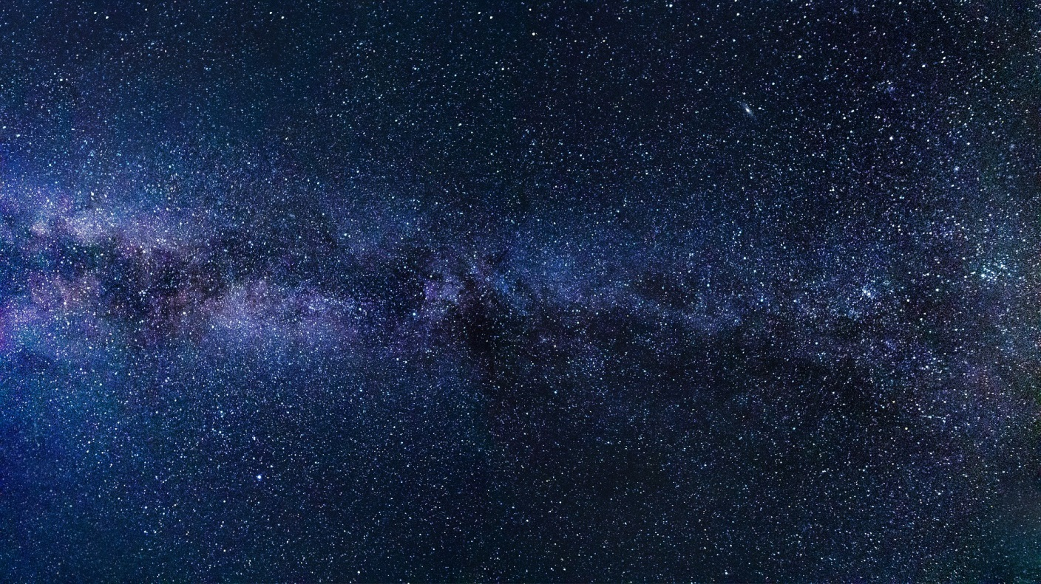

Oyts – Build A Universe
Fred Hansen
Notes:
https://trca.ca/wp-content/uploads/2017/10/milky-way-2695569_1920.jpg
https://trca.ca/event/astronomy-on-the-spit/

Slide 2
The obligatory intro joke
Universe [yoo-nee-vurs] noun 1. A one-stanza hymn (or herm for the PC)

Slide 3
Why Oyts?
Everything has smaller parts
  Universe, galaxies, stars, planets, … people, organs, molecules, atoms, protons/neutrons, quarks, … ?
  Let’s jump ahead to the smallest
  What is simplest object?
Gravity & quantum theory at odds
  Must coalesce space and its contents
Hence: oyts & oyt spaces

Slide 4
An Oyt Points to Oyts
An oyt is a shell holding 0, 1, or 2
one-way pointers to oyts
Two identical linked oyt groups
    each has three 2-oyts, two 1-oyts, one 0-oyt
(3-, 4-, or more-oyts are less simple, but not more useful)
≡
a
a
Notes:
https://www.nasa.gov/sites/default/files/styles/full_width/public/feb_25_x_5_pre-flare-sunspot_crop1.jpg?itok=0ebNDKPX
https://www.nasa.gov/content/goddard/giant-sunspot-makes-third-trip-across-the-sun

Slide 5
Oyts are Shapeless and Spaceless
Imagine all oyts are in one “place”
Travelers inside an oyt space perceive space by how many oyts they pass
Dimensions arise from how many directions await the traveler

Slide 6
An Oyt Space has GRSs
A Graph Rewriting System (GRS) is a set of rewrite rules
Each rule seeks a pattern & replaces its oyts with others
  example rule:
An oyt space is a connected collection of oyts where each is associated with its own GRS
  (in many cases, the GRS has no rules)
a
b
a
b

Slide 7

Pointless example
Starting space:
A rule for oyt a:
  (but oyts are colorless)
Pattern matches
Result
a
b
b
a
b
a
b

Slide 8
Rule Patterns
Oyts are all alike; so are pointers
  for simplicity
Pattern cannot test equality
Pattern can only test the size of an oyt
  0-oyt, 1-oyt, or 2-oyt
The pattern must be strictly a tree
  no loops, no shared subtrees
  (otherwise match test is impossible)
a
b

Slide 9
Rule Replacements
The replacement is arbitrary
It replaces the contents of the associated oyt and may associate a new GRS with it
The replacement associates a new GRS with each inserted oyt
Pre-existing pointers to replaced oyts will still point where they did
a
b

Slide 10
Simplest Example
Make a string of oyts
  Rule set (1 rule)
  the new 0-oyt has same rule
  the root (now a 1-oyt) is given no rules
Start with one 0-oyt
Apply rule four times getting
Nothing stops this oyt space
  infinite size
  but still occupies no physical space

Slide 11
Why “oyts”
Decimal arithmetic has 10 digits
Binary arithmetic has 2 digits: 0 & 1
  named “bits” for BInary digiTS
Unary arithmetic has 1 digit, say 1
  4 is 1111
  Addition is easy; concatenate
Zero-ary arithmetic has no digits
0-arY digiTS

Slide 12
Distinguishing Oyts - List Links
List link needs
  pointer to list item (as oyts)
  pointer to next link
1-oyt vs 2-oyt
  the pointer to a 1-oyt
  leads to next link
  the pointer to a 2-oyt leads to
      a 0-oyt
      the list item value
Diagram with blue arrows
Can now do lists
next list link
this item
next list link
list item
item 3
item 2
item 1

Slide 13
Example: Addition
Sum is a list of two unary integers
Initial GRS at sum removes first of val2 and replaces GRS for sum
New GRS at sum prepends a 1-oyt to val1 and restores GRS at sum
Initial GRS also looks for an empty val2; if found, remove sum’s GRS
Similarly for subtract and multiply
sum
val2
val1

Slide 14
Designer Defines Scaffold
A scaffold is an oyt space definition
  what kinds of connections will exist
  what GRS at each kind of node
Can simulate space as points
In one design, each point is a list
List elements – in order
  pointers to adjacent points in space
  pointers to values at the point
    examples: temperature & wind velocity

Slide 15
GRS for temperatures
Suppose a hot and a cold object
GRS adjusts their temperatures by a constant times the difference
Exponential, as per Newton

Slide 16
Points in simulated space
Now space as squares or triangles
Or cubes or tetrahedra
Gravity: space-time is warped
Warped space is easy with oyts
Warped time is a future development

Slide 17
We can create space
Rules to create a triangled space
  0: starter 0-oyt ⇒ trapezoid
  1: a bottom right triangle
  adds two triangles
  2: flattop adds layer
  3: cliff adds two triangles
Could define inflation
2↑
3
→
3
→
3
→
1
→

Slide 18
The π Problem
π is circumference over diameter, c/d
Both are altered by point space
r = 4, d = 8, c = 32, π = 4, OOPS
Getting π right is an open question

Slide 19
Local Action
To forbid worm holes the scaffold design should not allow distant links
Each GRS rule applies only locally
All GRSs operate independently and asynchronously

Slide 20
Segue to Our Universe
That’s it for defining oyts
  Confusing perhaps, but no controversy (There is also a description of GRS operation in terms of h-oyts)
Now let’s speculate on how a Designer might have defined an oyts scaffold for our universe

Slide 21

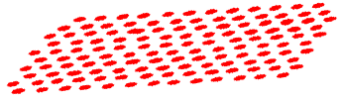
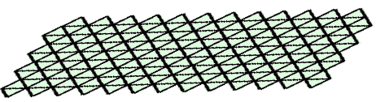
Light is Waves
Electrical and magnetic vectors at each point in space (E & M)
GRS continuously transforms the vectors based on neighbors
magnetic field
electric field
space layer

Slide 22
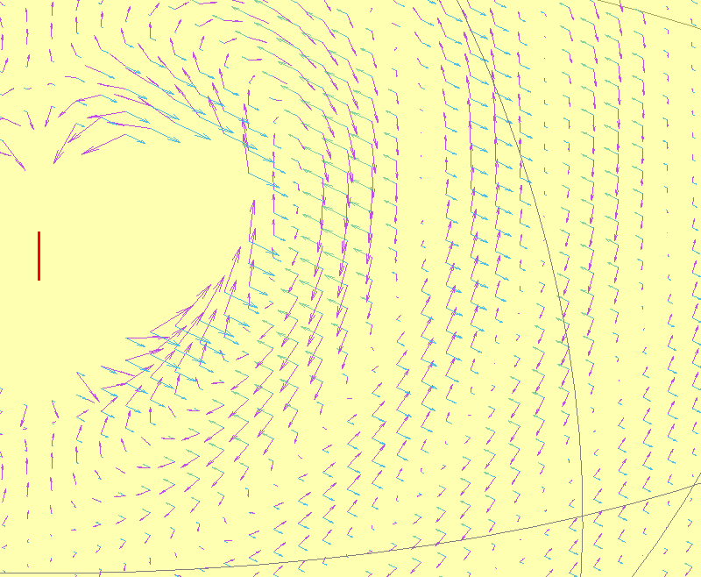
E & M Fields Drive Each Other
Notes:
http://mriphysics.github.io/teaching-antennas.html
http://mriphysics.github.io/images/HzDipole_3D_quiver_inclE_zoom.gif

Slide 23
Photons are Waves/Electrons
Electron-ness, and nucleon-ness are also layers of vectors
Photon is transfer from E/M to electron
  some energy (amplitude) from E/M moves to electron vector, or vice versa
  depends exactly on how the vectors interact (somewhat random)

Slide 24
Mass & Gravity
Mass is “time” required to move an “object”
Most mass is in nucleons; bigger objects have more nucleons
Changing the nucleon-ness field involves also adjusting the space scaffold
  More adjustment means more effort
  Harder to move = more mass
  Changing space warps it: GRAVITY

Slide 25
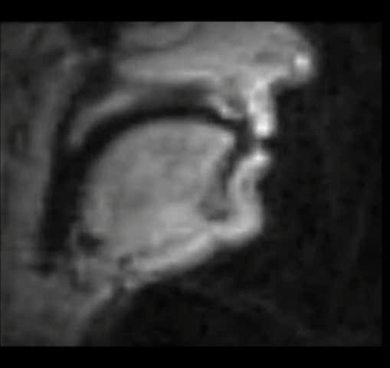
Objects Move by GRSs
Objects emerge from the fields
Many oyts to sing a herm
Notes:
http://player.vimeo.com/video/12251154?autoplay=1
http://sail.usc.edu/span/index.html

